Slide 1
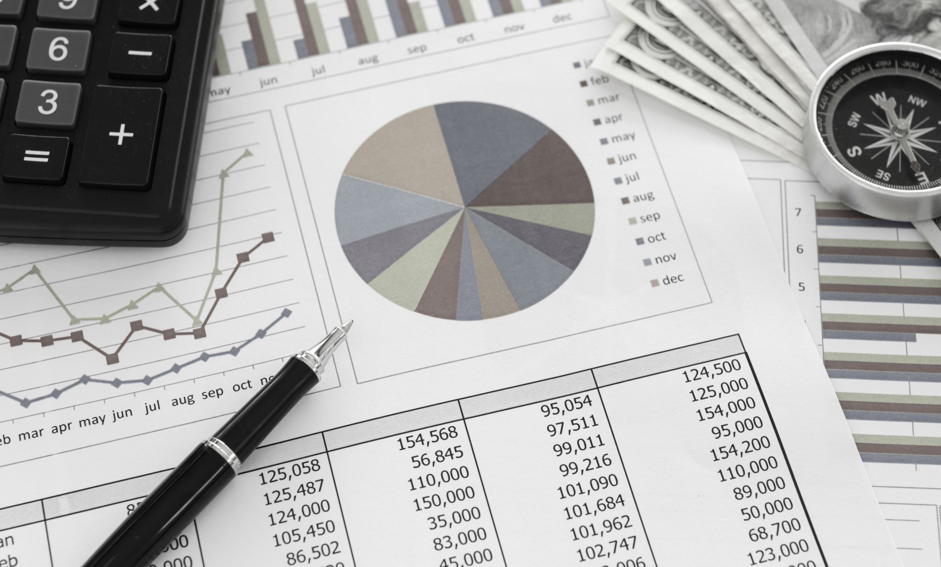
Project “FinWIN”
Hosted By: The Logistic Regressions! Alexis Reyes, Jordi Salas, Patricia Fuglo

Slide 2



MOTIVATION AND SUMMARY
OUR GOAL: USE TECHNOLOGY & ML FOR USER-FRIENDLY ROBO ADVISORS
HELPING NEW USERS START FINANCIAL PLANS EASILY
(GEARED TOWARDS MARGINALIZED COMMUNITIES)
INSPIRED BY RECENT SUCCESSFUL FINTECH APPS LIKE ROBINHOOD & ACORNS

Slide 3





DATA CLEANUP & MODEL TRAINING
Data Exploration and cleanup: Conducted thorough data exploration and cleaning. Addressed challenges such as missing data and outliers. Ensured data quality and reliability by resolving inconsistencies
Data Preparation: Prepared data with feature engineering and transformation, ensured data readiness for model training
Training the Model: Leveraged the prophet model for time series forecasting. Choose prophet model for its ability to handle seasonality. Deployed cloud resources to efficiently process large datasets
Unexpected challenges: Faced data inconsistencies and missing values during data cleanup. Overcame challenges through careful revision

Slide 4
Levering Prophet to Optimize our Learning Model
Forecasting: Using cleaned up dataset, identified and isolated specific areas of interest (more on this later).
Trend Modeling: Prophet automatically models both hypotheticals both short and long-term, to identify trends that support our analysis.
Data Collection: Combination of easy to find historical financial data, alongside the moderate challenge of finding unique data to support our mission. (Racial Wealth Gap)

Slide 5



SUMMARY OF FINDINGS
Data Visualization: The project includes extensive data visualization powered by Plotly and Matplotlib, to assist in user experience with acknowledged visual cues helping communicate the plan.
Income Inequality Analysis: Using abundance of information provided by US Census Bureau and US Treasury, Federal Reserve and other federally sanctioned, we determine "HDI Rank 2021 or “Human Development Index” to be feature dataset for dependent forecasting..
Financial Data Retrieval: We leverage real-time and historical information using Yahoo Finance API to handpick specific technical analysis and indicators to simulate, juxtapose and correlate this "Wealth Gap." with actual/historical Market conditions.
Correlation Analysis: Our analysis is harped on the notion of whether such correlation exists, while still recognizing the opportunity to assist individuals of all financial literacy backgrounds.

Slide 6
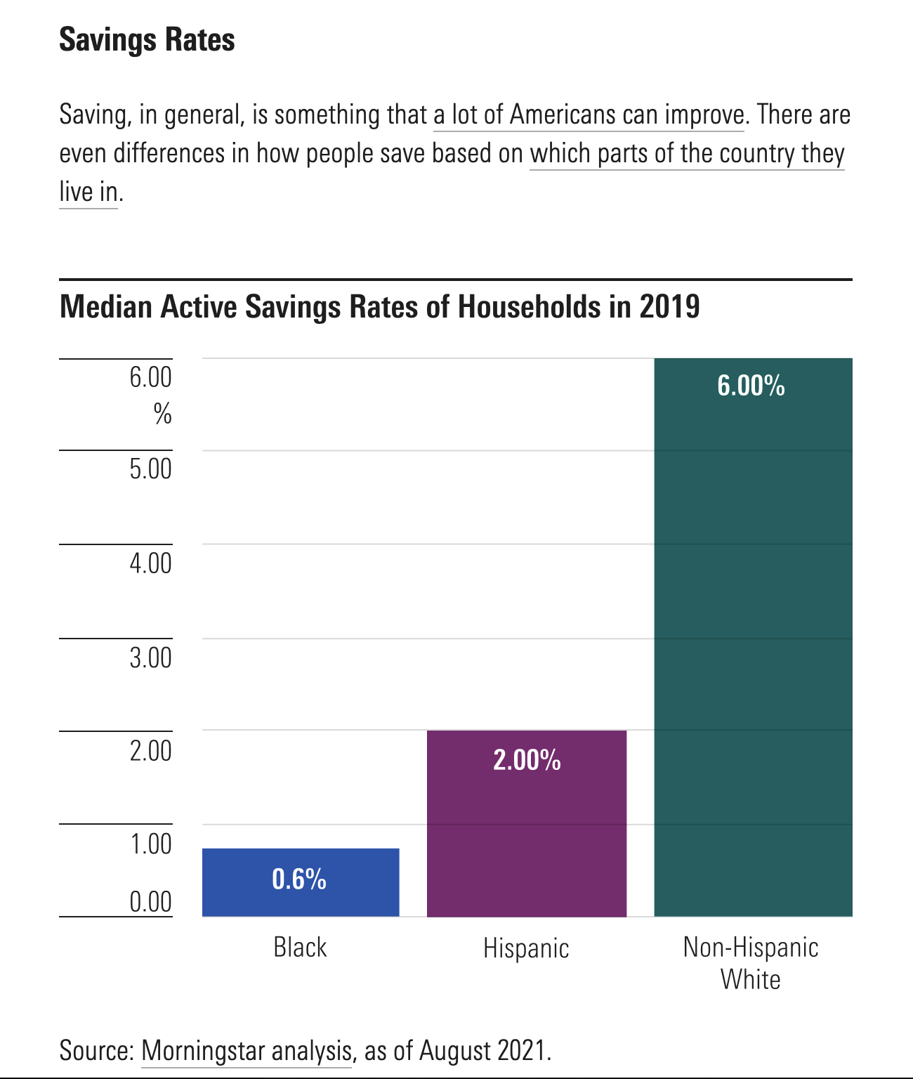
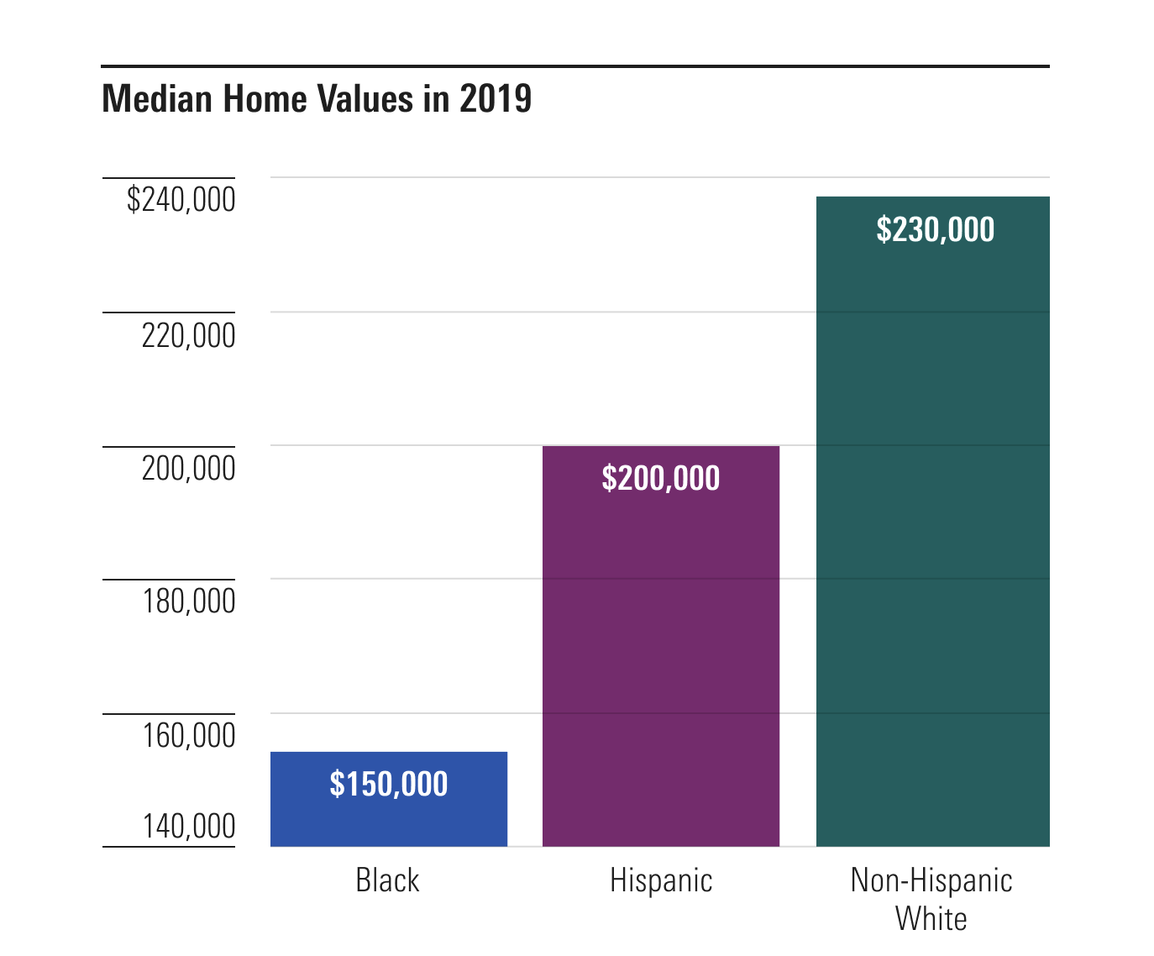
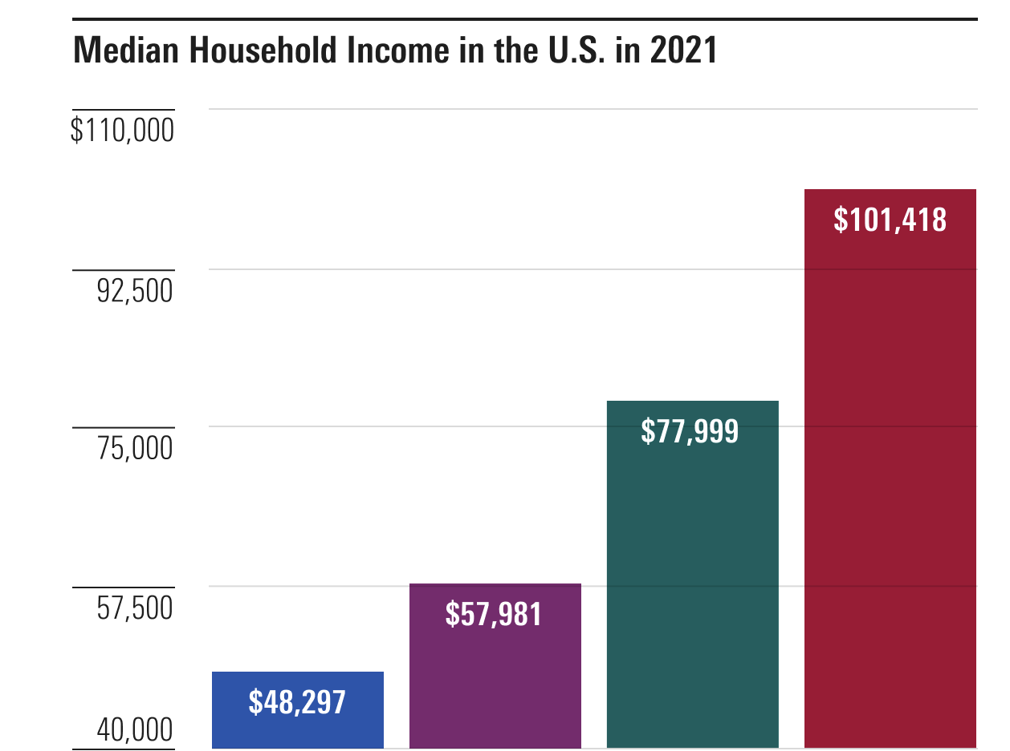
Proportionate Economic “Indicators” in the Non-Anglo Community

Slide 7
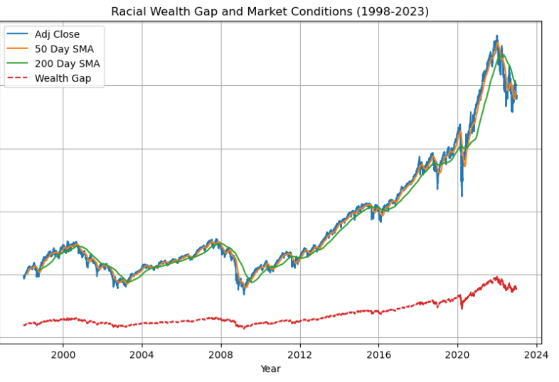
Concept of Racial Wealth Gap alongside actual historical Market Data for last quarter century. (initial render but being used for Illustrative Purpose)
Worth noting: Correlation analysis and visualization between “Adj Close” and “Wealth Gap” using a heatmap

Slide 8
ANALYSIS CONCLUSIONS AND
FINTECH SOLUTIONS
To make true. Global and Domestic impact, we must hone and leverage technology to make Financial Education, Literacy and Planning more:
Accessible
Easy to Comprehend
Cost Effective
Safe and Trustworthy (Language Dialects)
Core Solutions
Banking Accounts
Investment Products
Home / Real Estatement
Retirement
Speculative Strategies
Sources can be found on Github!
https://github.com/fintech-lex/finance-starterkit

Slide 9
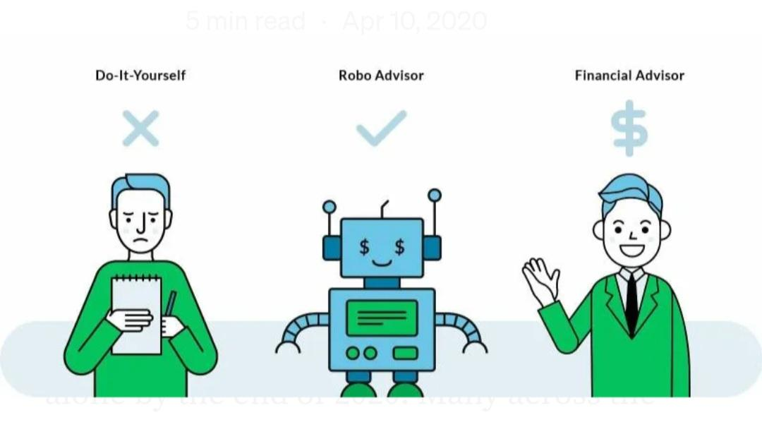
ROBO ADVISORS

Slide 10

QUESTIONS?

